Slide 1
Scientific Research And Literature (SPEC9997)

Slide 2
Common Research Methods within Software Development:
Benchmarking
Erez, T., Tassa, Y., & Todorov, E. (2015). Simulation tools for model-based robotics: Comparison of Bullet, Havok, MuJoCo, ODE and PhysX
Wu, F., Cabral, M., & Brazelton, J. (2010). High Performance Matrix Multiplication on General Purpose GPUs
Case Study
Mendozaa, J. F., Ordóñez, H., Ordóñez, A., Juradoa, J. L. (2017). Architecture for embedded software in microcontrollers for Internet of Things (IoT) in fog water collection.
Begel, A., Nagappan, N., Poile, C., & Layman, L. (2009). Coordination in Large-Scale Software Teams
Action Research
Jaakola, H., Thalheim, B. (2005, September). Software Quality and Life Cycles.
Mendozaa, J. F., Ordóñez, H., Ordóñez, A., Juradoa, J. L. (2017). Architecture for embedded software in microcontrollers for Internet of Things (IoT) in fog water collection.
Experiment
Lujan, M., Baum, M., Chen, D., & Zong, Z. (2019). Evaluating the Performance and Energy Efficiency of OpenGL and Vulkan on a Graphics Rendering Server. 2019
Horváth, I. 2007. Comparison of three methodological approaches of design research. In: DS 42: Proceedings of ICED 2007
Survey
Begel, A., Nagappan, N., Poile, C., & Layman, L. (2009). Coordination in Large-Scale Software Teams
Mellon, A. I. W. C., Wasserman, A. I., (2010, November 1). Software engineering issues for mobile application development.

Slide 3
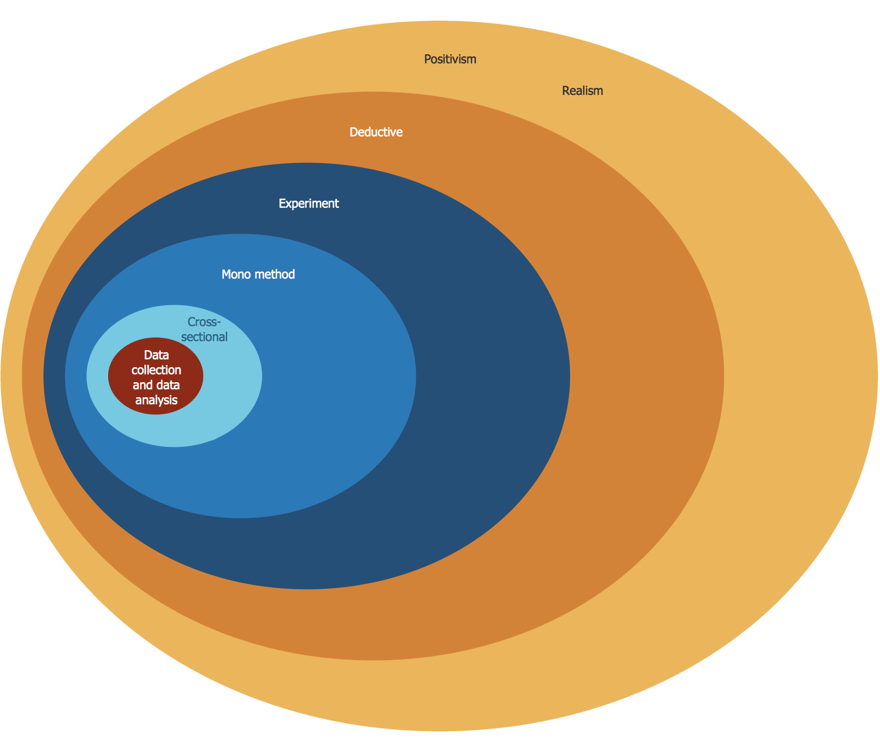
Research Method - Benchmarking
Epistemology
Concerns ‘hard’ data rather than opinions
Positivism & Realism
Quantifiable, reproducible results
Deductive
Confirm hypothesis through
quantitative research
Experiment
Reproducible results
Statistical data
Mono-Method
Quantitative
Cross-sectional
Data Collection & Analysis
Profiling tools
Comparing results to draw a conclusion
https://www.conceptdraw.com/samples/management-stakeholder-onion-diagrams

Slide 4
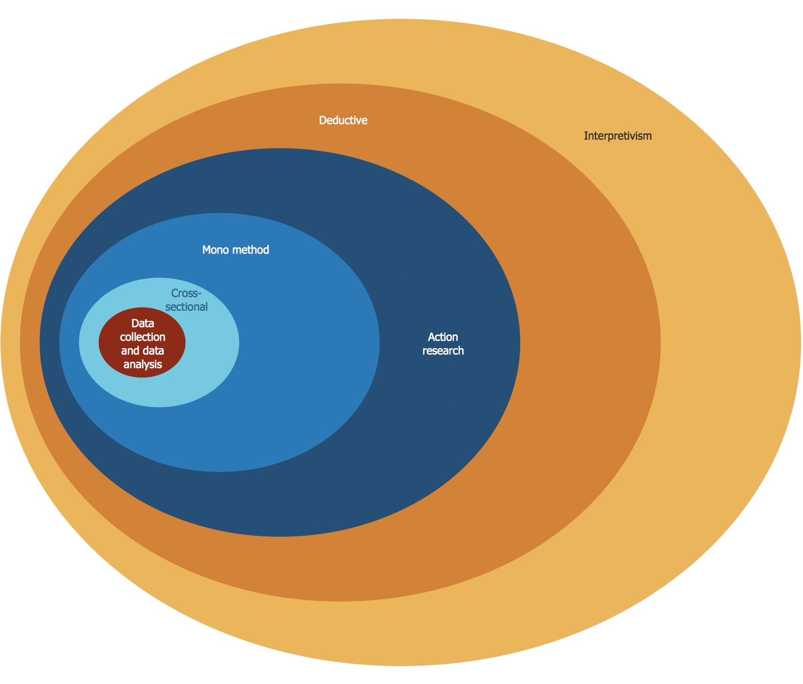
Research Method - Action Research
Epistemology
Concerned with the nature and study of knowledge
Interpretivism
Researcher is part of the research, interprets data and as such can never be fully objective and removed from the research
Deductive
Moves from a clear objective to diagnosis of the problem
Action Research
Primary focus is on solving real problems
Mixed-Methods
Quantitative/Qualitative
Cross-sectional
Data Collection & Analysis
Research journal,
Document collection and analysis,
Participant observation recordings,
Questionnaire surveys,
Structured and unstructured interviews,
Case studies
https://www.conceptdraw.com/samples/management-stakeholder-onion-diagrams

Slide 5
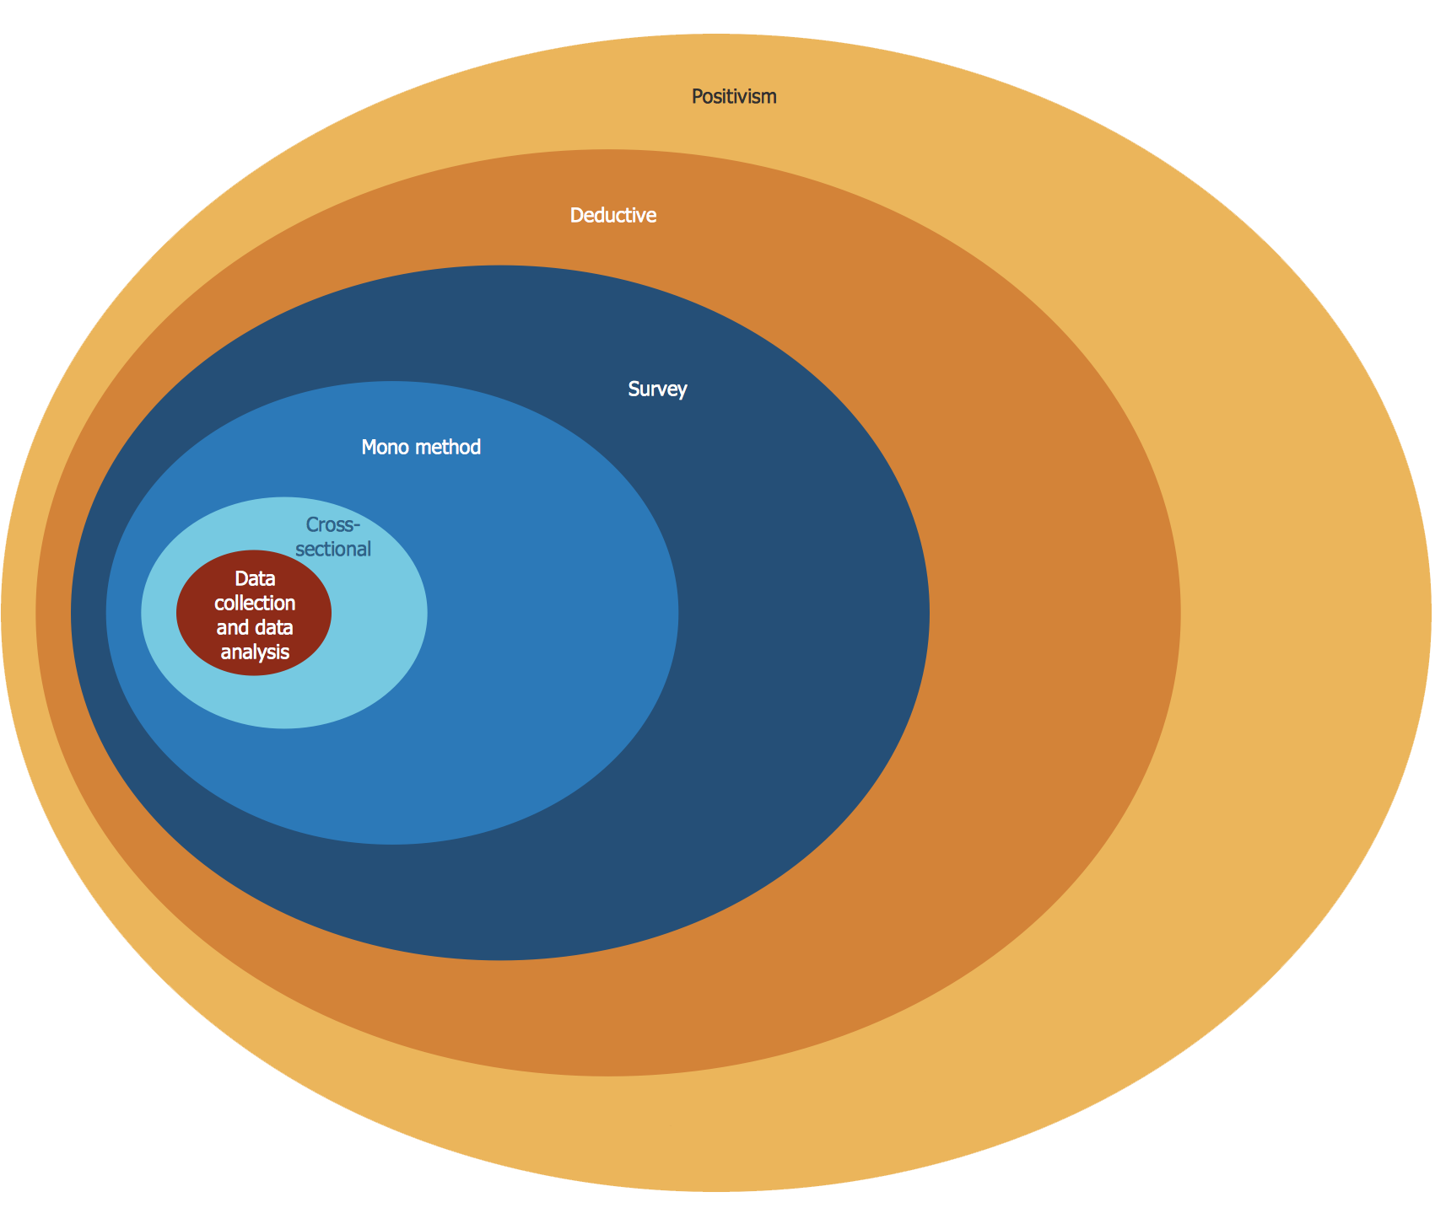
Research Method - Survey
Epistemology
Tries to find the acceptable knowledge and addresses
the facts accordingly
Positivism
Quantifiable variables collected and
interpreted in an objective way
Deductive
Start with theories that determine the appropriate observations
Survey
Snapshot of the situation to capture the current status
Mono-Method
Quantitative
Cross-sectional
Data Collection & Analysis
Questionnaires
Interviews
https://www.conceptdraw.com/samples/management-stakeholder-onion-diagrams

Slide 6
Performance of OpenGL and Vulkan -
Conference Paper:
Evaluating the Performance and Energy Efficiency of OpenGL and Vulkan on a Graphics Rendering Server
(Luhan, Baum, Chen, Zong, 2019)
Philosophy:
Positivism - The authors of the paper performed a number of experiments with a focus on creating quantifiable, reproducible results.
Approach:
Deductive - The paper begins with a hypothesis. The authors then set out to accumulate data in order to test and confirm it.
Research Strategies:
The Experiment strategy was used throughout the paper in the form of a series of benchmarking experiments.
These experiments also show the choice of a Mono-method approach resulting in Quantitative results.

Slide 7
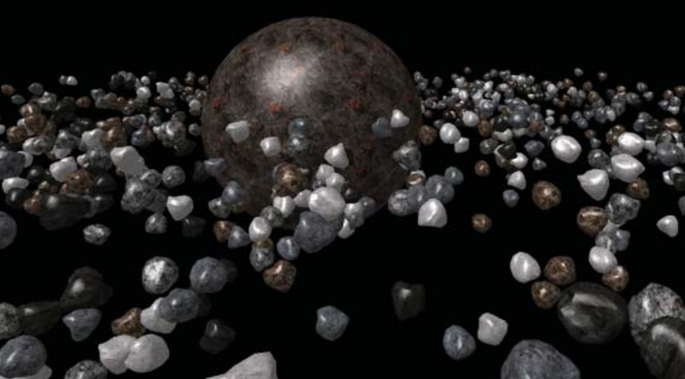
Performance of OpenGL and Vulkan -
Time Horizons:
Cross-sectional - The paper does not consider performance/power
consumption improvements over a long period of time.
It only considers these on current hardware at the time
of the study.
Data Collection/Analysis Methods:
Orbiting Rocks Application
Intel Powerlog Tools - Used to log CPU statistics
Nvidia Management Library - Used to log GPU statistics
6 experiments were performed to measure and compare CPU/GPU power consumption and overall frame rate
Static Instanced Draw Calls
Static Indexed Draw Calls
Dynamic Instanced Draw Calls
Dynamic Indexed Draw Calls
Frame Rate Instanced Draw Calls
Frame Rate Indexed Draw Calls
Orbiting Rocks Application. (Luhan et al., 2019)

Slide 8
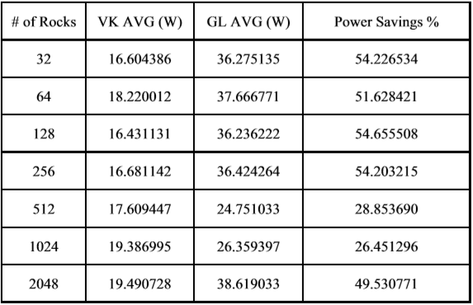
Performance of OpenGL and Vulkan -
Data Collection/Analysis Methods:
The authors then reached their conclusion by comparing
the measured power consumption and performance of
OpenGL and Vulkan in each of the experiments.
Research Gaps:
The authors ran benchmarking experiments using only a single
software and hardware configuration. Also, the authors only
compared Vulkan to OpenGL ES, a slimmed down version of
the OpenGL API for use on embedded systems.
Possible Future Research:
Possible future research could include examining Vulkan and OpenGL performance across multiple hardware configurations and platforms.
Instanced draw call results (Luhan et al., 2019)

Slide 9
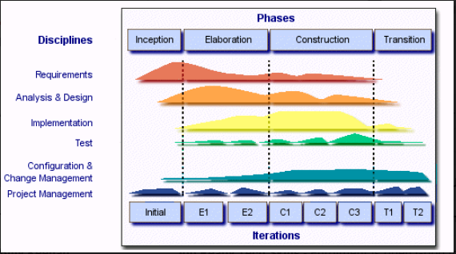
Problems caused by Software quality goals in different life cycle phases -
Conference Paper:
Software Quality and Life Cycles’ (Jaakkola & Thalheim, 2005)
What is Software Quality? It is a loose definition.
Overall Quality
Specification Quality
Design Quality
Intensity of efforts mapped through the development cycle

Slide 10
Problems caused by Software quality goals in different life cycle phases -
Research Strategy:
The strategy that paper uses is grounded theory and action research. The researchers cite several past publications in order to comment on existing trends and subsequently formulate their own theory and it is conducted within the researcher’s own field of expertise.
Approach:
This paper uses the inductive approach. From the outset, there is no particular hypothesis stipulated. The paper observes the (sometimes) overlapping concerns that developers, stakeholders and end users have as regards Software Quality. In conclusion, tentative principles are formed to best cater for the goals of all concerned to avoid conflicts between the goals of Software Design at given stages of the life cycle.

Slide 11
Problems caused by Software quality goals in different life cycle phases -
Choices Made:
Due to the loose definition of ‘quality’, the researcher takes the qualitative choice in this paper. It analyses practices such as Object Oriented Development and Software Product Line Engineering (SPLE) and how they can affect certain non-functional criteria such as learnability and suitability.
Time Horizons:
This paper is based on cross-sectional research by considering of the state of Software Development priorities at the time of writing.
Data Collection/Analysis Methods:
Data is collected for this research using archival research through the systematic referencing of peer reviewed publications. These particular publications used observational surveys to collect and map their data to visual aids such as graphs.

Slide 12
Coordination in Large-Scale Software Teams -
Conference Paper:
Coordination in Large-Scale Software Teams
(Begel, Nagappan, Poile, Layman, 2009)
Philosophy:
Positivism - The researchers collected and interpreted the data in an objective way.
Approach:
Deductive - Accumulating data with the purpose of testing a hypothesis is a deductive research approach. This study collects data aiming to understand both the inter and intra-team dependencies of large scale software development processes, coordination mechanisms and communication techniques used as well as the the level of success each of these techniques have.
Research Strategies:
The research was conducted using an anonymous web based survey, a flexible approach that can be used to study a wide variety of basic and applied research questions. Invitations to take part in the survey were sent by email to 2,535 individuals including developers, testers, program managers, architects and user experience engineers, consisting of a 10% random sample in each job role.

Slide 13
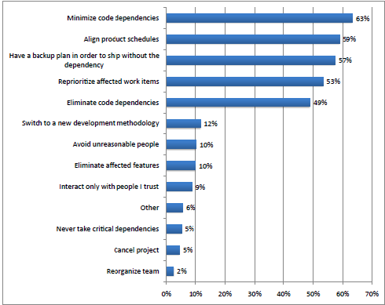
Coordination in Large-Scale Software Teams -
Time Horizons:
Longitudinal - The survey was outlined as a once off, longitudinal case study and it was available to the participants for two weeks in 2007. The study was completed inside Microsoft Corporation.
Data Collection/Analysis Methods:
The data analysis was applied to 775 remaining respondents after removing 45 invalid responses from a total of 820 received. The data collected was used by the researchers to build a series of stats and charts, presenting this to the reader with the aim of understanding where and how improvements can be made.

Slide 14
Coordination in Large-Scale Software Teams -
Research Gaps:
One of the remarks we can make regarding this conference paper after the evaluation, is that this study was carried inside Microsoft Corporation and the findings can only represent this company and not the entire software industry.
Possible Future Research:
Future research could be a larger evaluation including multiple companies. Collected data can be used to compare with the facts presented in this paper creating and testing a new hypothesis, aiming to prove the results found by this research apply broadly to the software industry.

Slide 15
Action Research for the Internet of Things -
Paper:
Architecture for embedded software in mircocontrollers for Internet of Things (IoT) in fog water collection
(Mendozaa, Ordóñez, Ordóñez, Juradoa, 2017)
Research Strategies:
The paper is an example of Action Research. The authors start with a problem - a shortage of clean drinking water that causes environment, health and social problems. They propose a solution to this problem and then evaluate the solution with a case study. Based on their evaluation, they conclude that the architecture they provide can be used for a Fog Water Collection system.
Approach:
The paper uses a deductive approach. The paper starts with a clear statement: the need for a Fog Water Collection system to provide clean drinking water. From this statement, the authors move to implementing a solution for this problem. From the implementation, they then move to data collection through a longitudinal case study.

Slide 16
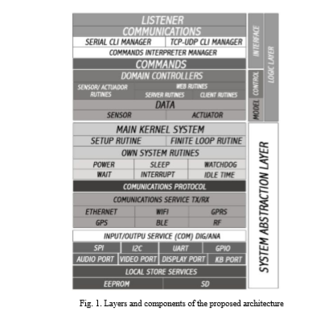
Action Research for the Internet of Things -
Data Collection/Analysis Methods:
The paper uses a Mixed Method. The authors evaluate their architecture both qualitatively and quantitatively.
They use the Architecture Tradeoff Analysis Method to evaluate the qualitative functional requirements, i.e. what sensors, algorithms, communication protocols, configuration options, etc. it should use.
They also evaluate non-functional requirements such as performance, interoperability, usability, flexibility, maintainability, security and scalability. Other non-functional requirements they evaluate are the architectural style and the patterns included in the architecture.

Slide 17
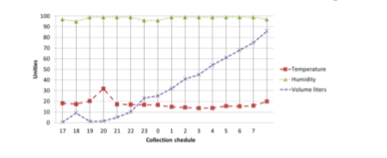
Action Research for the Internet of Things -
Data Collection/Analysis Methods:
The paper uses a Mixed Method. The authors evaluate their architecture both qualitatively and quantitatively.
They define various quantitative variables - temperature, humidity and volume of collected water - and then specify what micro-controllers are to be used to measure these. This quantitative data is then collected over 2 months in a case study. They set up a prototype of their system in a mountain village called Montanitas. The prototype both collects fog water and returns statistical data on this water.

Slide 18
Action Research for the Internet of Things -
Research Gaps:
The paper measures the volume of water collected but it does not measure the quality of said water. They note this is one possible application of the architecture in future research.
The philosophical stance that best describes this paper is positivism. As such, it does not consider social and cultural factors in the interpretation of data. Other philosophical stances may take into account subjective factors such as how user-friendly the system is to people who did not design it, or whether the people who drink the collected water consider it to be of an acceptable standard.
Possible Future Research:
In addition to water quality measurement, the authors note that the proposed architecture can be evaluated in other domains, such as river flow control and air quality management.

Slide 19
Software Engineering issues for mobile app development -
Software engineering issues for mobile application development (Anthony I. Wasserman, 2010)
Nature - Qualitative
Type - Basic
Purpose - Analytical
The paper is an example of basic research. The author is basically concerned with formulating a theory at the end of the research.
The philosophical stance of the research paper is one of pragmatism because it falls under the ontology stance. This stance is used to find solutions to a problem. The research paper looks to provide an overview of the research issues related to the development of applications that run on mobile devices.

Slide 20
Software Engineering issues for mobile app development -
Approach
The paper implements an inductive approach to it. It seeks to gain a better understanding of development practices for mobile applications. An inductive approach seeks to study data and record patterns and provides strong evidence for conclusion.
Strategies
A survey was used in the paper and some conclusions were made based on the survey. A survey strategy is often associated with a deductive approach but in this case it is used in conjunction with an induction approach. There is a set theory. The paper basically observes a phenomenon based on a theory.
Choice
The research paper uses qualitative research in forms of survey. Qualitative research is concerned with rich data. It relies on data that are in the form of words. The survey was posted on developer forums and data was gathered.

Slide 21
Software Engineering issues for mobile app development -
Time Horizon
The author of the paper implements the cross-sectional design. It's a short term study that measures the behaviour of a group of individuals(developers).
Techniques and Procedure
The method used in the paper is in the form of a survey. The tools used were the developer forums online to solicit responses from developers. These responses were then used to formulate a better understanding of the development practices for mobile applications. This was done over the time frame of 6 weeks.

Slide 22
Data Minimization model -
Conference Paper:
A data minimization model for embedding privacy into software systems
Awanthika Senarath, Nalin Asanka Gamagedara Arachchilage, 2019
https://doi.org/10.1016/j.cose.2019.101605
Philosophy:
Interpretivism- authors of this paper gather users’ insights and opinions first and then design a solution based on their findings.
Approach:
The paper implements Design Science Research approach with a goal to construct a new reality (i.e. solve problems) instead of explaining an existing reality, or helping to make sense of it (Iivari and Venable, 2009). Authors attempt to solve problem, create change and improve existing solutions by generating new knowledge, fresh insights and theoretical explanations.
Design Research can be divided into three phases (Horvath, 2007):
1. Exploration, induction and deduction of the problem, the context and the activities and setting hypothesis.
2. Design and testing of the solutions.
3. Verifying hypothesis, validation of the research and generalising towards other applications.
Authors of the paper propose and evaluate methodology that allows developers to understand and implement Data Minimization during software design process. Methodology designed by authors of this paper is tested and evaluated in three studies. First experiment is conducted to implement the methodology, second to evaluate it and test it, and third experiment is conducted to measure acceptance levels among participants.

Slide 23
Data Minimization model -
Research Strategies:
Authors use action research and case study strategies to implement, evaluate and test level of acceptance of proposed methodology. Paper tries to evaluate three studies:
1. How understanding data could help software developers to minimize the use of data in software system designs.
2. How software developers engage with a methodology that enables them to understand the data used in a software system design
3. How a privacy engineering methodology that enables developers to understand data would encourage system designs to minimize the use of data.
Choices:
This paper uses mixed methodologies to gather research data on Privacy Engineering Methodology. Authors use quantitative research strategy to determine the model to identify the significant determinants of developers’ intention to use the privacy methodology, and use qualitative data to get insights in developers’ design decisions while incorporating data into system design.
Time Horizons:
Although research data was collected from October to December 2016 and October to December 2018, the study measures behaviour and response developers at a single point in time, it should be therefore qualified as short-term study (cross-sectional).

Slide 24
Data Minimization model -
Data Collection/Analysis Methods:
Authors conducted two remote experiments (Study I, Study III), and participant observation workshop (Study II). Exit questionnaires were used to evaluate users experience for the first two studies and Technology Acceptance Model proposed by Hardgrave et al. (2003) based on five point Likert scale for the third study to evaluate a developer’s intention to use Privacy Engineering Methodology at work.
Research Gaps and Possible Future Research:
This paper tries to answer three research questions:
How understanding data could help software developers to minimize the use of data in software system designs.
How software developers engage with a methodology that enables them to understand the data used in a software system design.
How a privacy engineering methodology that enables developers to understand data would encourage system designs to minimize the use of data.
In doing so authors conducted three studies, Study I with 24 participants, Study II - 9 participants, and Study III - 149 participant. By involving large organizations or perhaps multinational corporations, this research could be conducted among larger group of participants, with added additional structure. Another noticeable limitation is use of only one scenario (Senarath and Arachchilage, 2019), web-based healthcare application, for simulating embedding privacy into software systems. Using different, more robust scenarios (social network application) could potentially improve proposed methodology.

Slide 25
References
Lujan, M., Baum, M., Chen, D., & Zong, Z. (2019). Evaluating the Performance and Energy Efficiency of OpenGL and Vulkan on a Graphics Rendering Server. 2019 International Conference on Computing, Networking and Communications (ICNC). doi: 10.1109/iccnc.2019.8685588
Erez, T., Tassa, Y., & Todorov, E. (2015). Simulation tools for model-based robotics: Comparison of Bullet, Havok, MuJoCo, ODE and PhysX. 2015 IEEE International Conference on Robotics and Automation (ICRA). doi: 10.1109/icra.2015.7139807
Wu, F., Cabral, M., & Brazelton, J. (2010). High Performance Matrix Multiplication on General Purpose Graphics Processing Units. 2010 International Conference on Computational Intelligence and Software Engineering. doi: 10.1109/cise.2010.5677044
Mendozaa, J. F., Ordóñez, H., Ordóñez, A., Juradoa, J. L. (2017). Architecture for embedded software in microcontrollers for Internet of Things (IoT) in fog water collection. Procedia Computer Science 109C 1092–1097.., doi: 10.1016/j.procs.2017.05.395
Iivari, J. and Venable, J. 2009. Action research and design science research-Seemingly similar but decisively dissimilar. In: ECIS 2009 Proceedings (online). Presented at the European Conference on Information Systems (ECIS). Available at: https://aisel.aisnet.org/ecis2009/73 Accessed: 2020-02-12.
Horváth, I. 2007. Comparison of three methodological approaches of design research. In: DS 42: Proceedings of ICED 2007, the 16th International Conference on Engineering Design, Paris, France, 28.-31.07.2007. Presented at the International Conference on Engineering Design, ICED’07, Paris, France. Available at: https://www.designsociety.org/download-publication/25512/comparison_of_three_methodological_approaches_of_design_research Accessed: 2020-02-13
Hardgrave, B.C. , Davis, F.D. , Riemenschneider, C.K. ,2003. Investigating determinants of software developers’ intentions to follow methodologies. Journal of Management Information Systems 20 (1), 123–151 .
Jaakola, H., Thalheim, B. (2005, September). Software Quality and Life Cycles. Paper presented at ABDIS 2005, Advances in Databases and Information Systems, Tallinn, Estonia. Retrieved February 5,2020 from https://www.researchgate.net/publication/221651304_Software_Quality_and_Life_Cycles
Begel, A., Nagappan, N., Poile, C., & Layman, L. (2009). Coordination in Large-Scale Software Teams. 2009 ICSE Workshop on Cooperative and Human Aspects on Software Engineering. doi: 10.1109/CHASE.2009.5071401
Mellon, A. I. W. C., Wasserman, A. I., Carnegie Mellon Silicon Valley, Washington University, & University of Virginia. (2010, November 1). Software engineering issues for mobile application development. Retrieved from https://dl.acm.org/doi/10.1145/1882362.1882443

